Slide 1

TEAM 8 COSC SKILL SERIES

Slide 2
TEAM 8 COSC SKILL SERIES
Vishnu Gadam - Cse(3/4)
Shashank Kandaala - Cse(3/4)
Deva Sudeeshna - Cse(2/4)
Aishwarya Mamidi - Cse(2/4)
S. Shashank - IT(2/4)
Snigdha Sathineni - Cse(1/4)
C. Chandrika - Cse(1/4)
Mahendranath Jinkathoit - Cse(1/4)
MENTOR: SAI MEENAN VOTURI

Slide 3
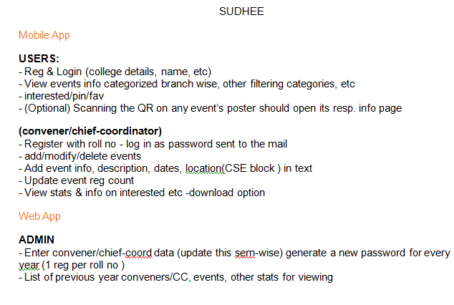
PROBLEM STATEMENT

Slide 4
TECHNOLOGY STACK
Flask restful with json web token for Api
Flutter for android
Django for web

Slide 5
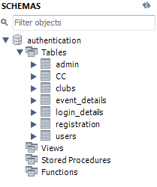
DATA BASE

Slide 6
PRIMARY KEYS AND FOREIGN KEYS
Admin table:
primary key : admin_id
CC table:
primary key : roll_no
foreign key : club_id
Clubs table:
primary key : club_id
Event_details table:
primary key : event_id

Slide 7
PRIMARY KEYS AND FOREIGN KEYS
Login_details table:
Primary key : user_id
Registration table:
Foreign keys : event_id
user_id
Users table :
Primary key : user_id

Slide 8
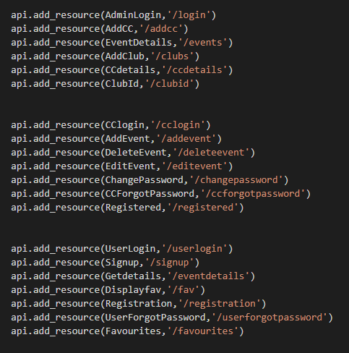
REST API

Slide 9
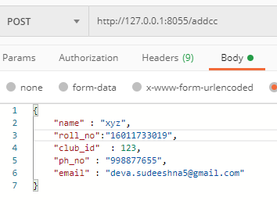
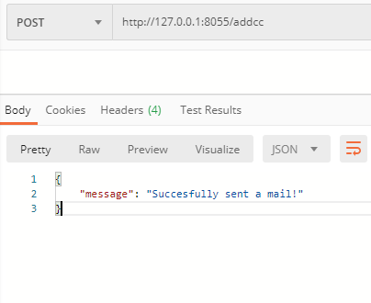
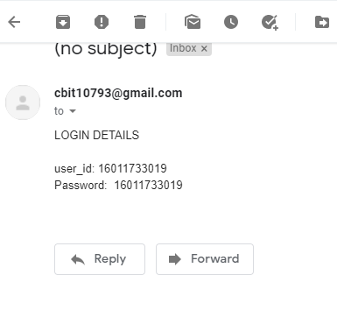

Slide 10
ANDROID

Slide 11

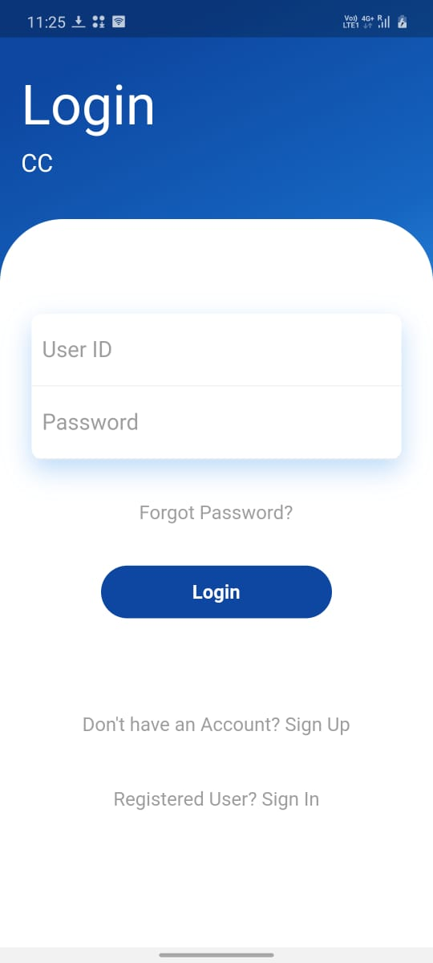
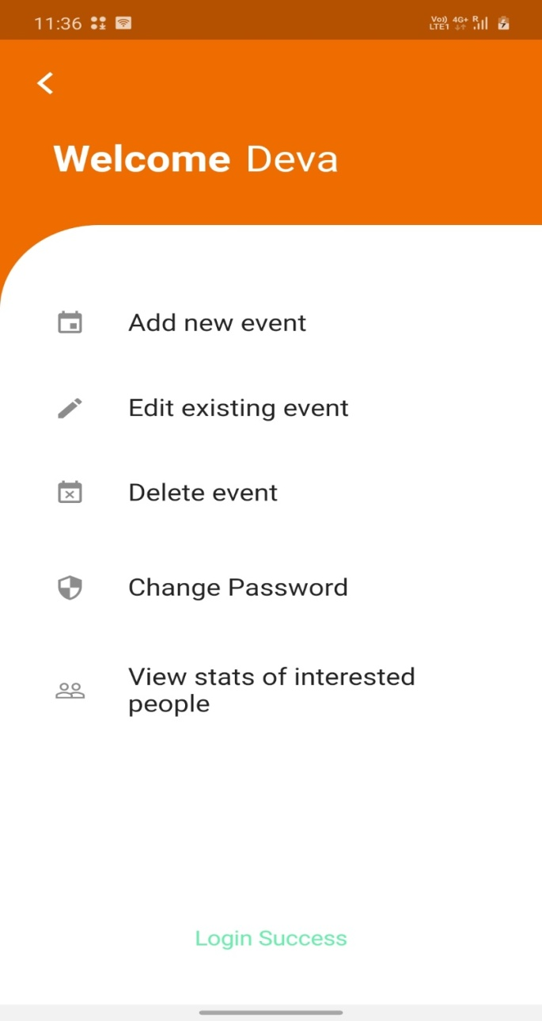

Slide 12
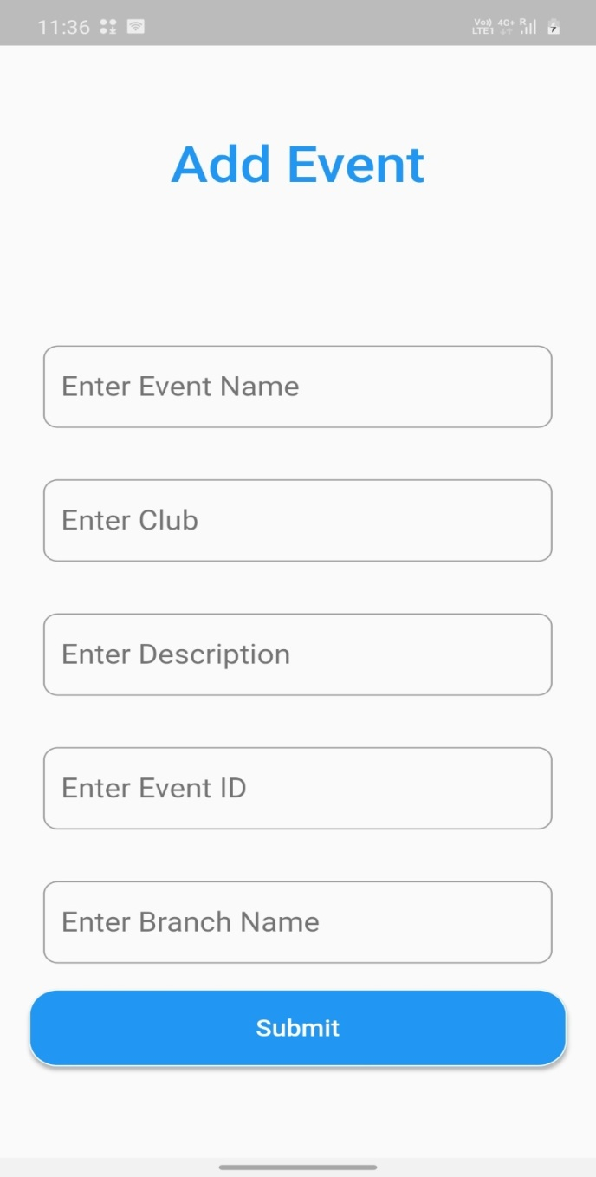
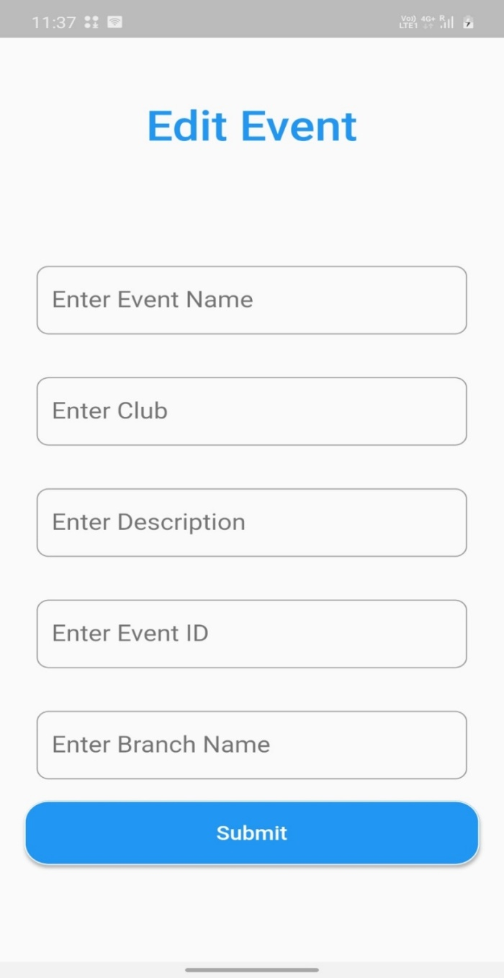
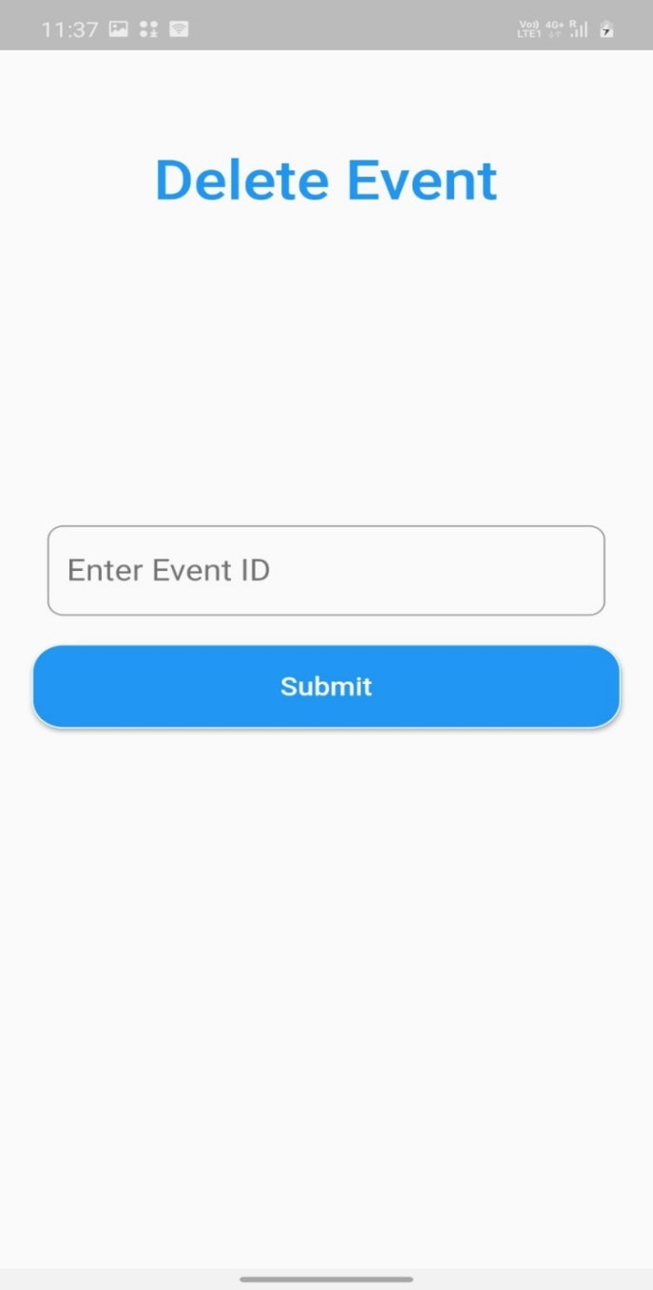

Slide 13
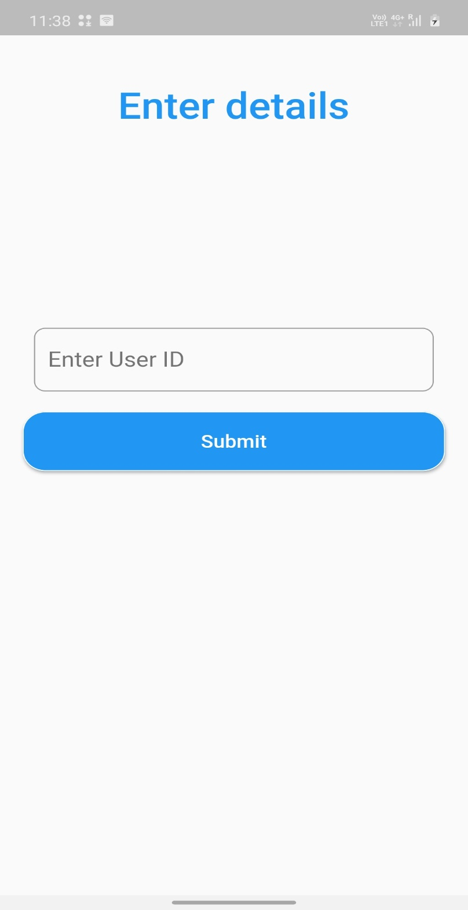
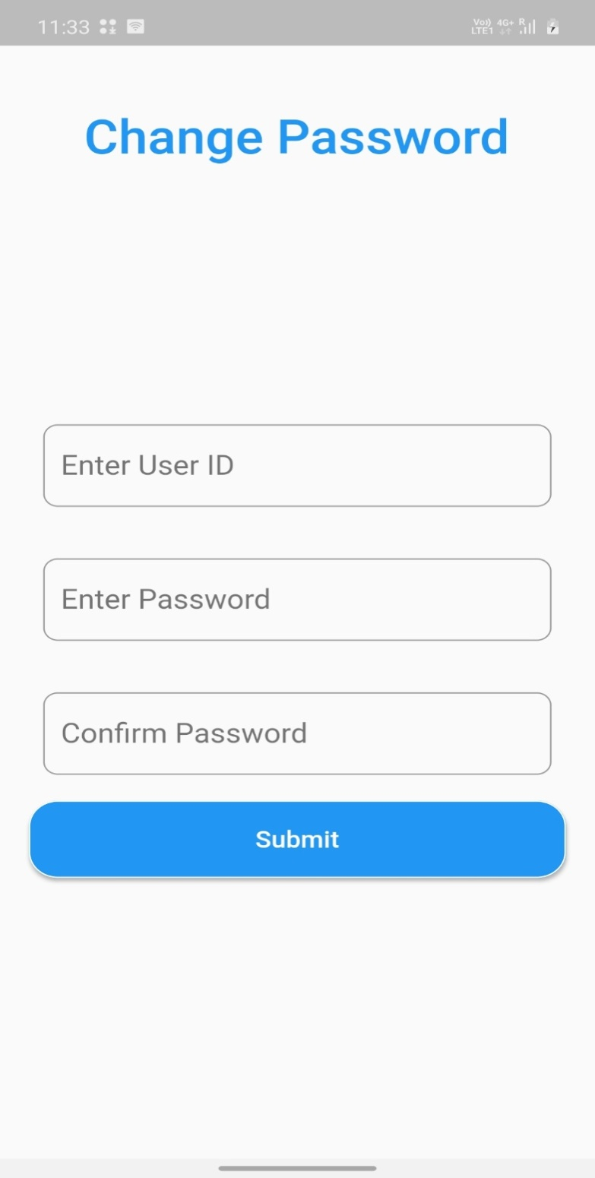

Slide 14

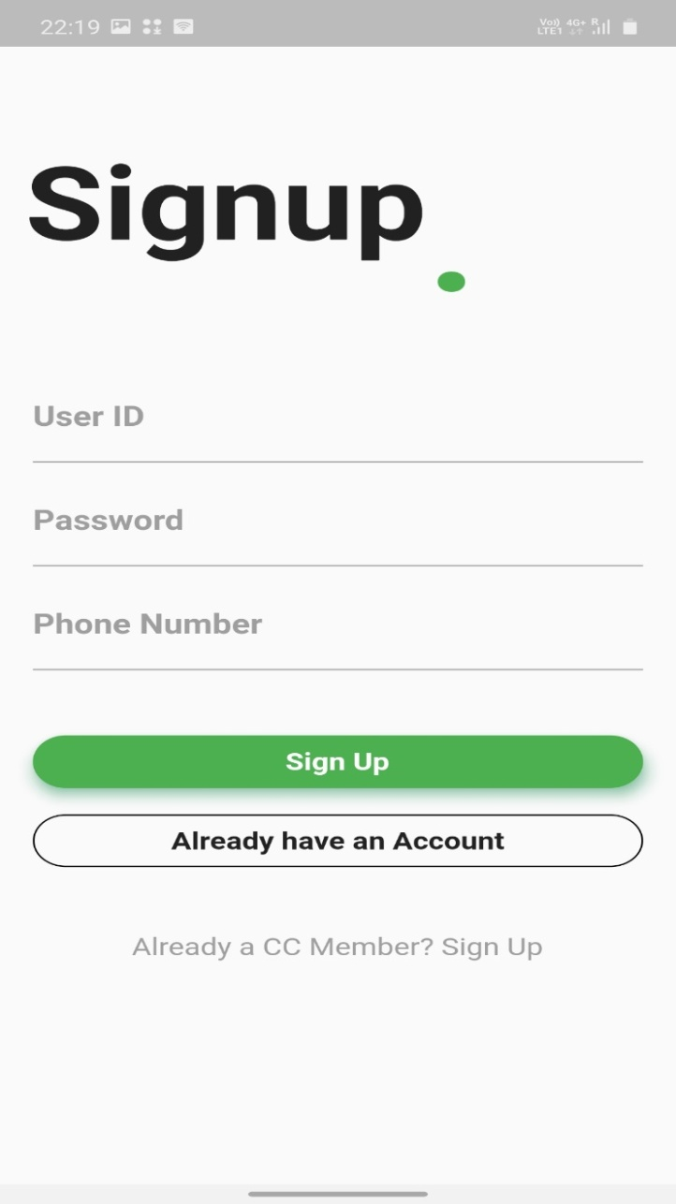

Slide 15

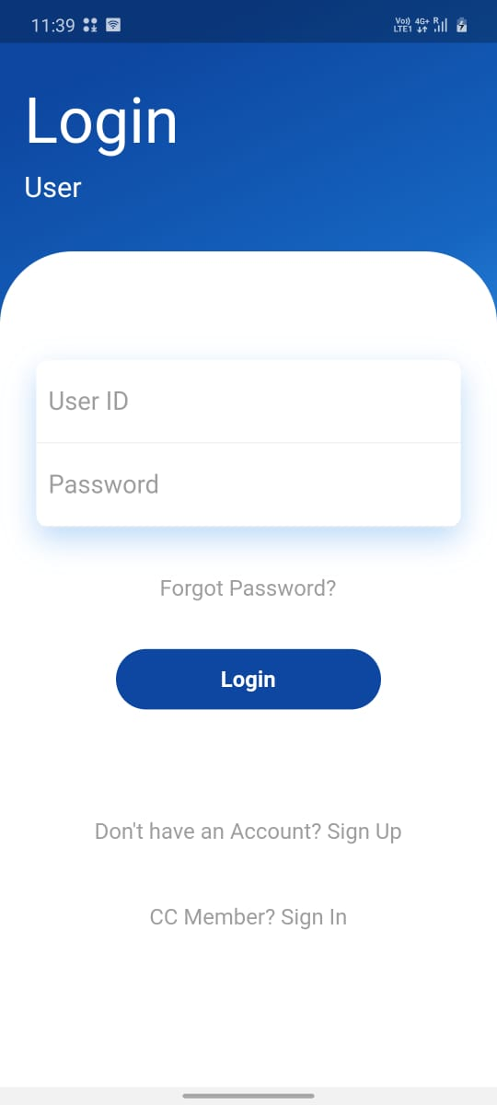
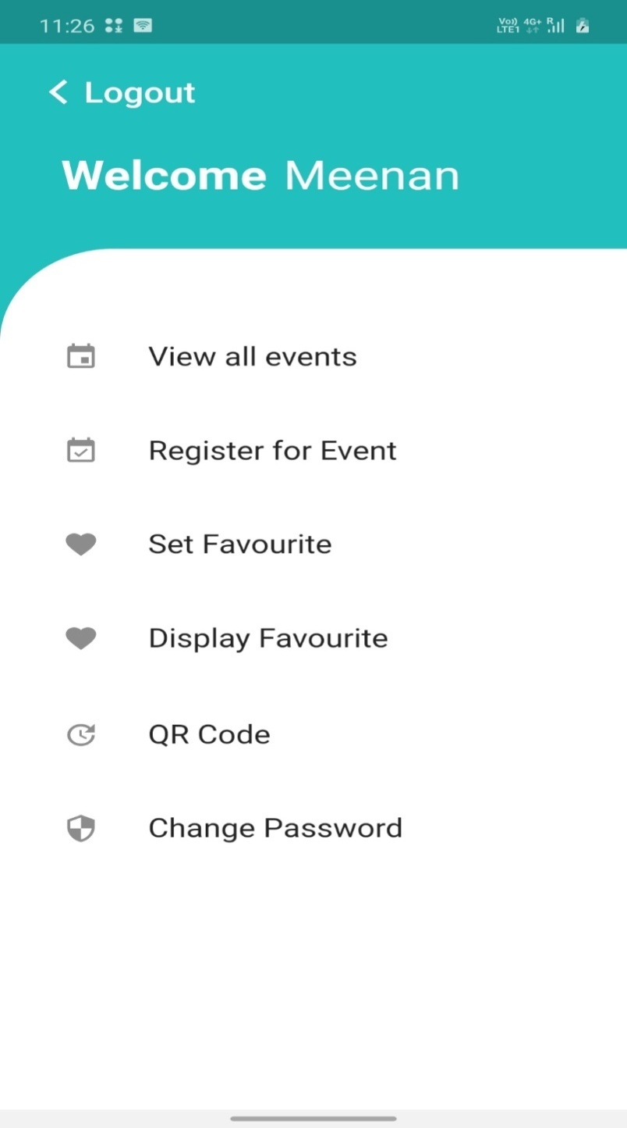

Slide 16

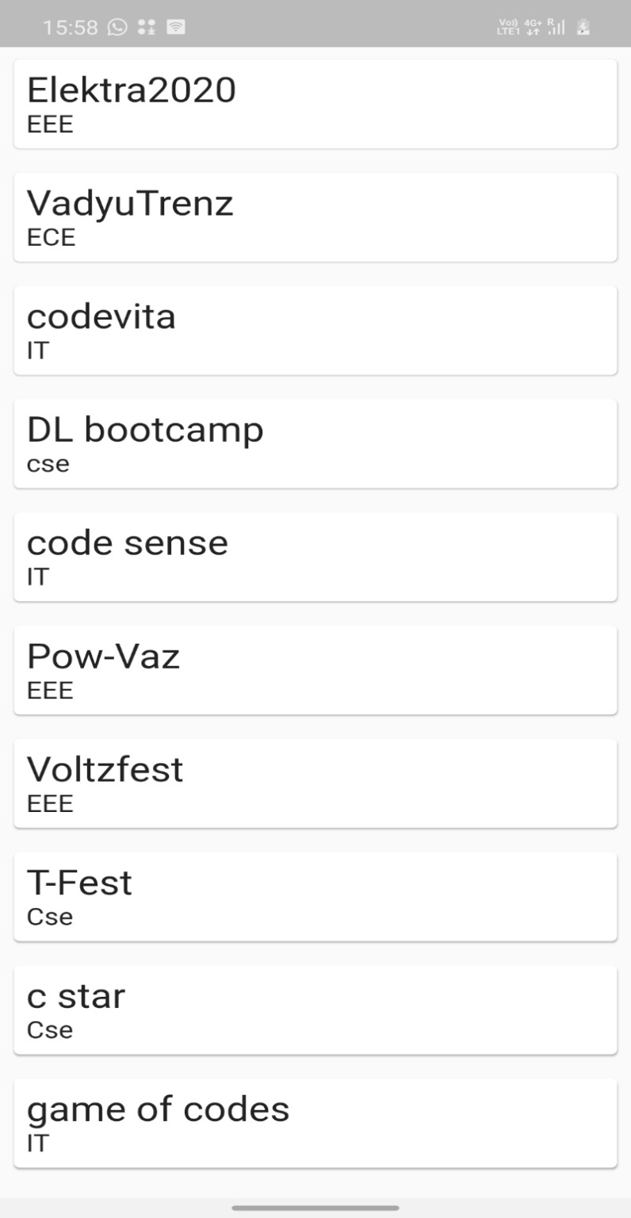

Slide 17

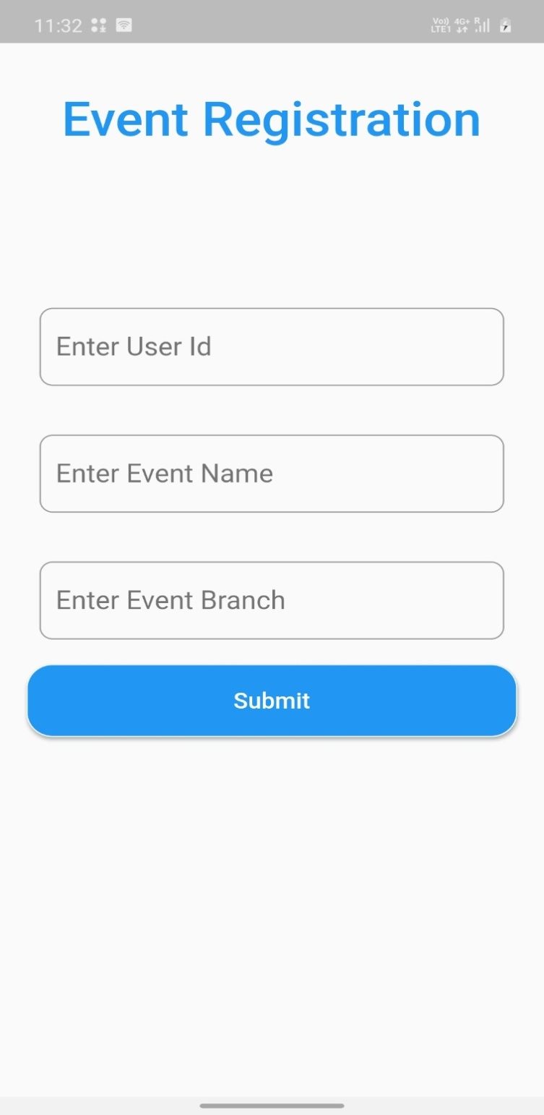

Slide 18

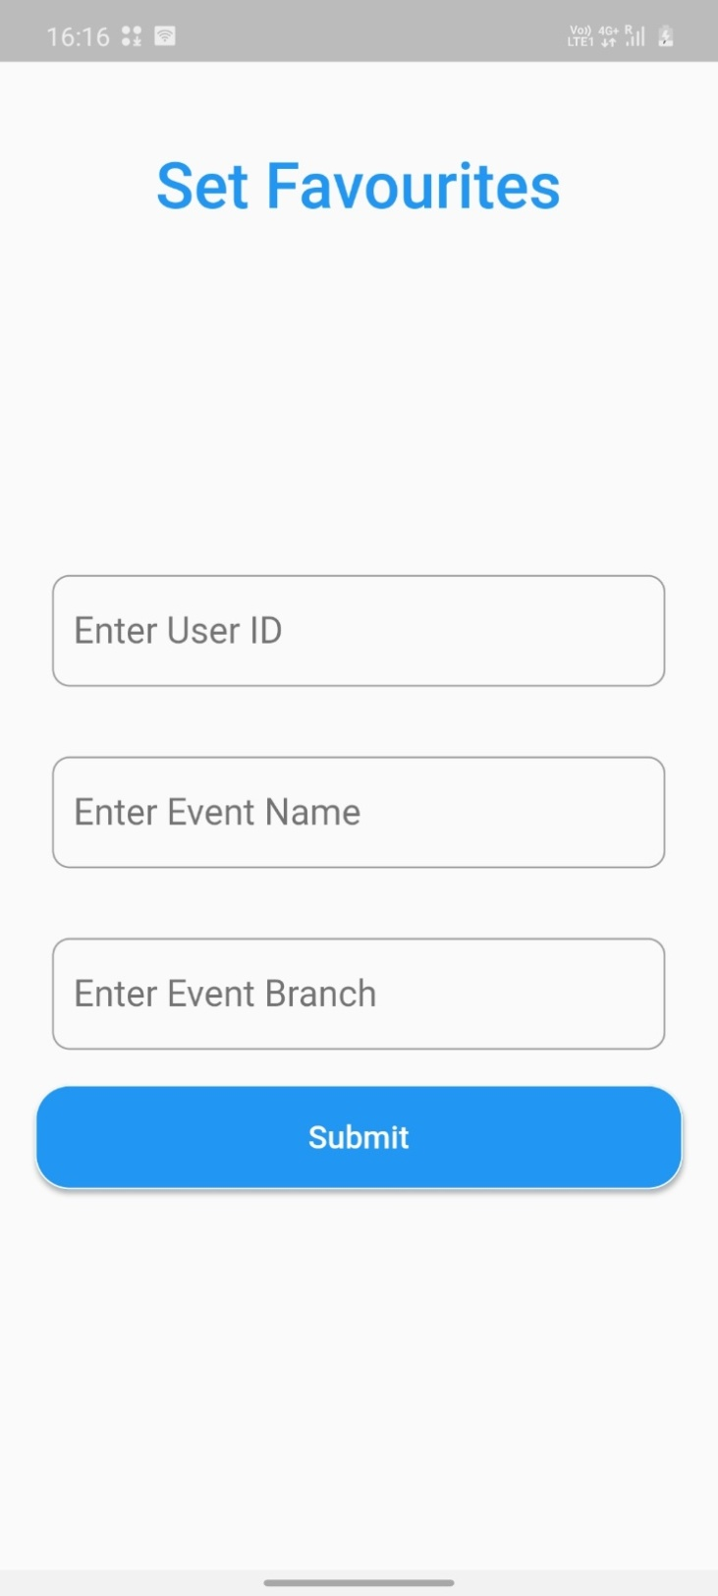

Slide 19
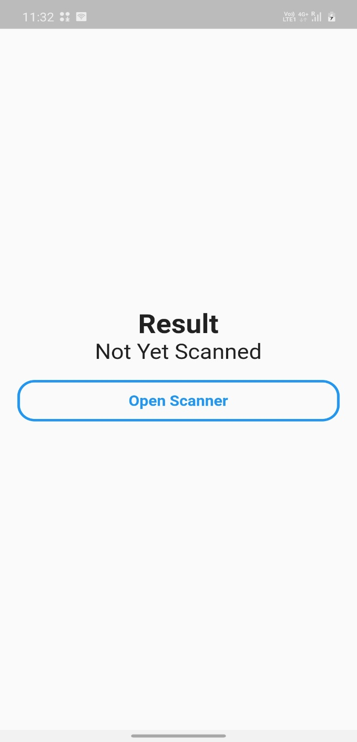
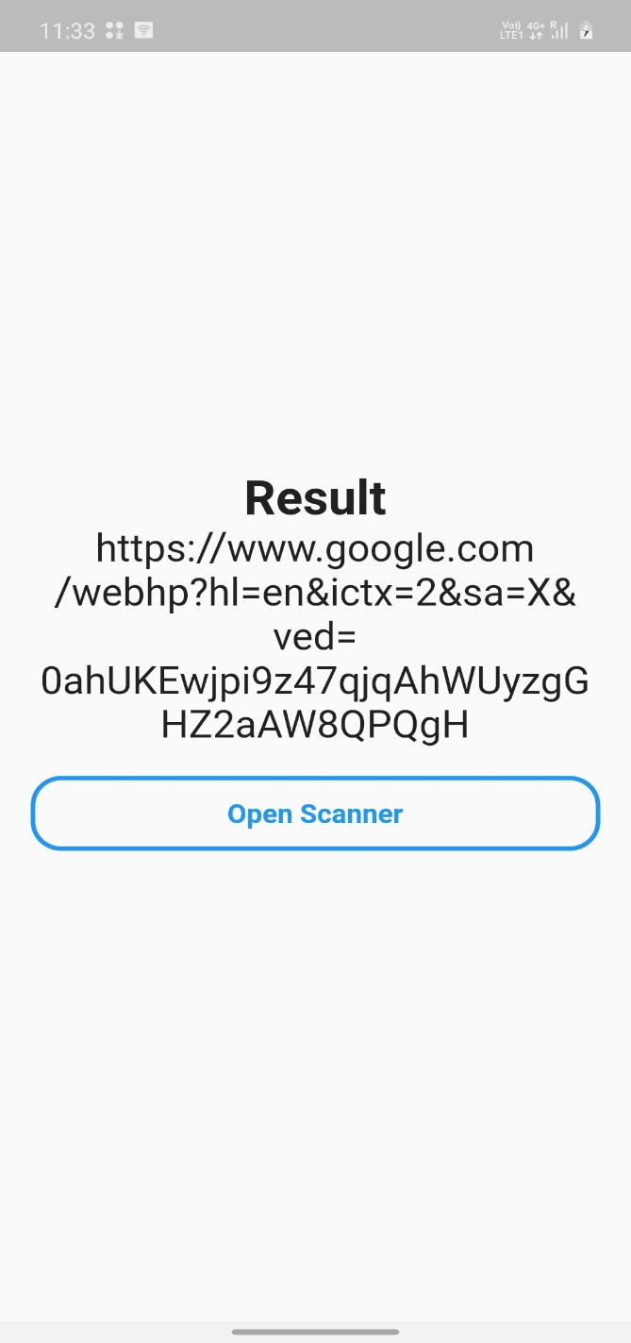

Slide 20

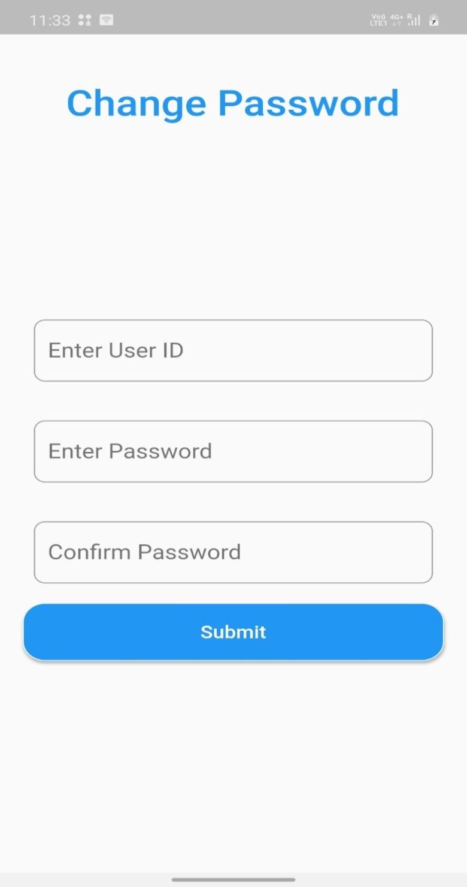

Slide 21
WEB DEVELOPMENT

Slide 22
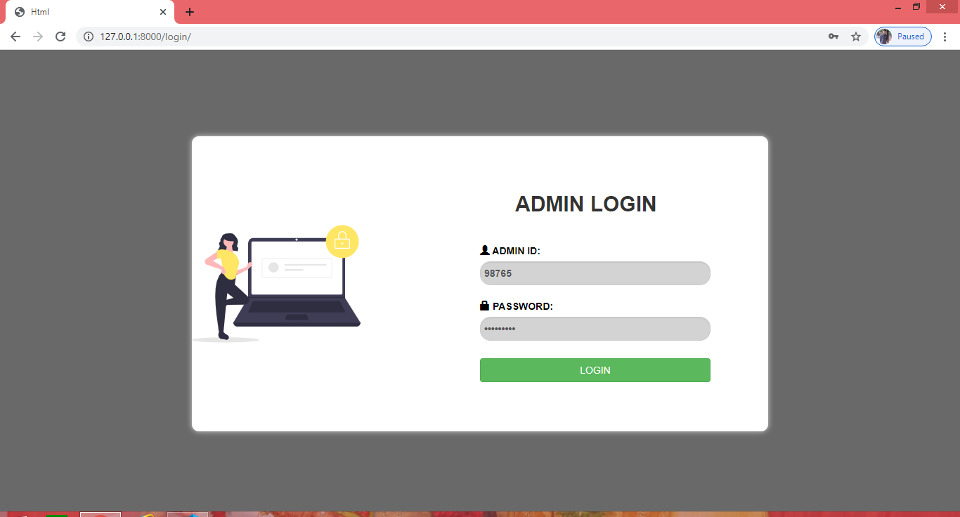
LOGIN PAGE

Slide 23
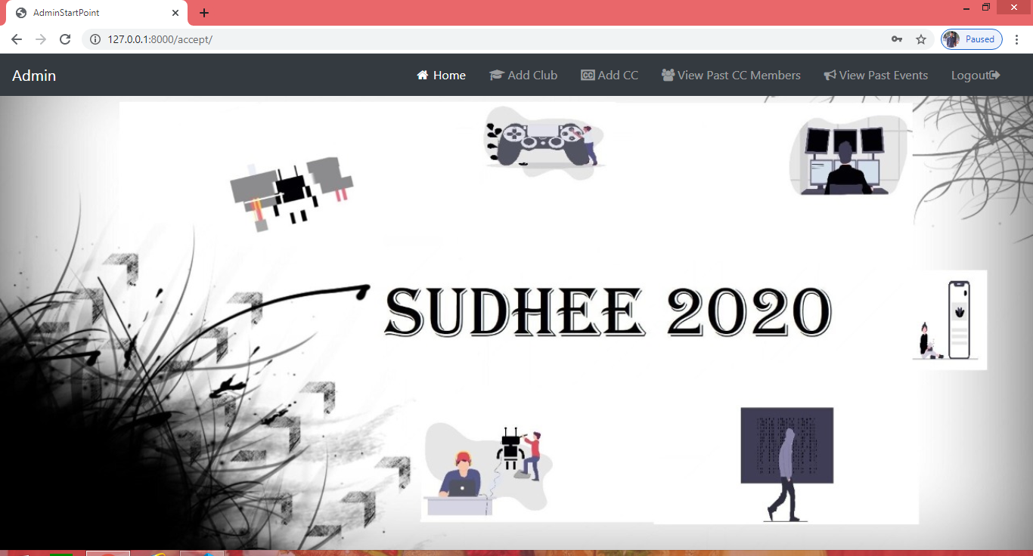
ADMIN HOME PAGE

Slide 24
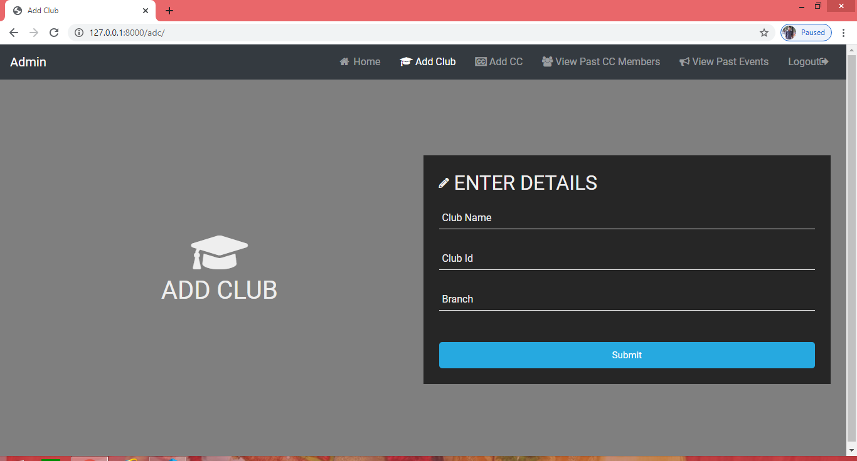
ADD CLUB

Slide 25
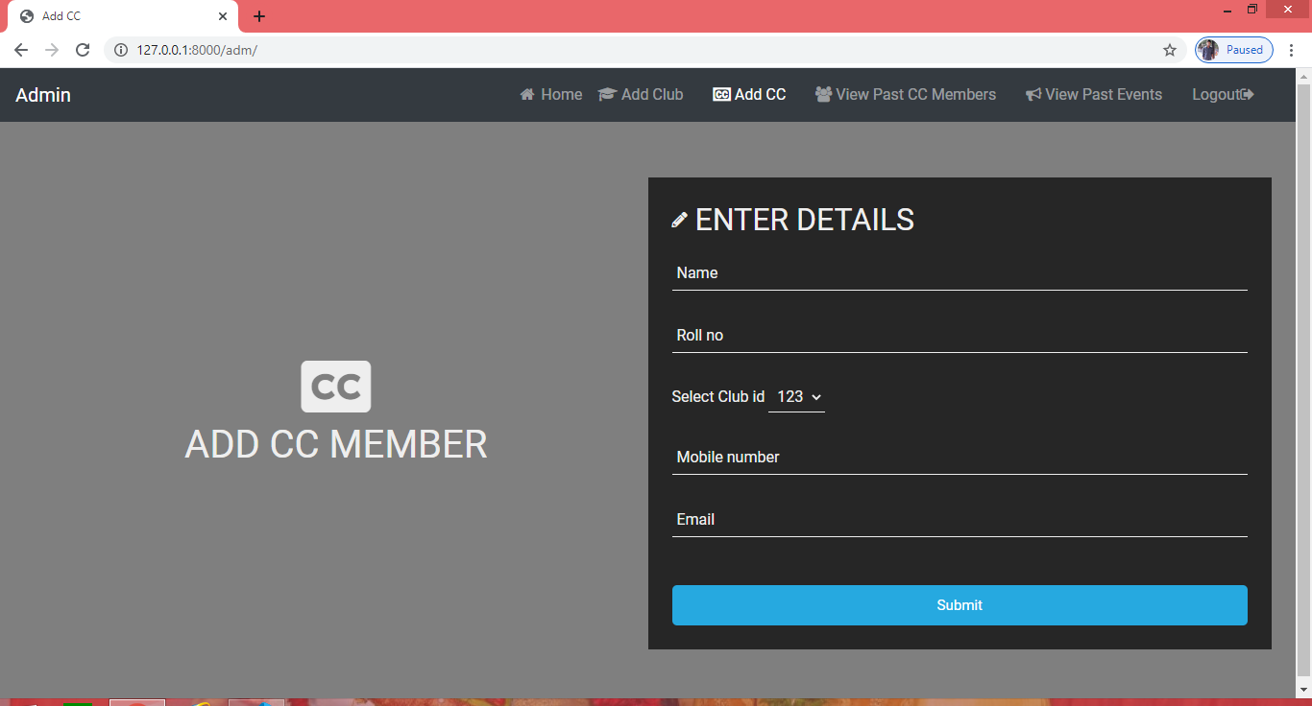
ADD CC

Slide 26
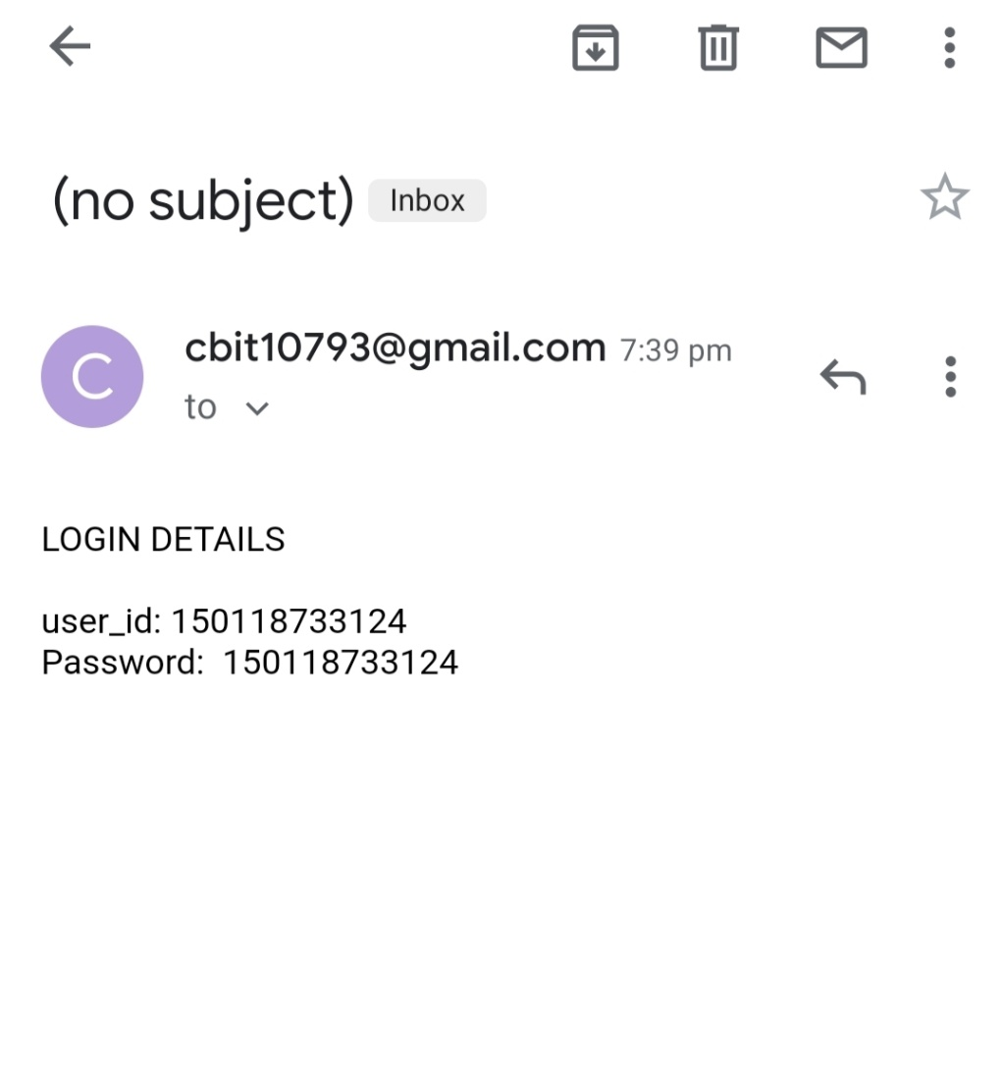
SAMPLE MAIL

Slide 27
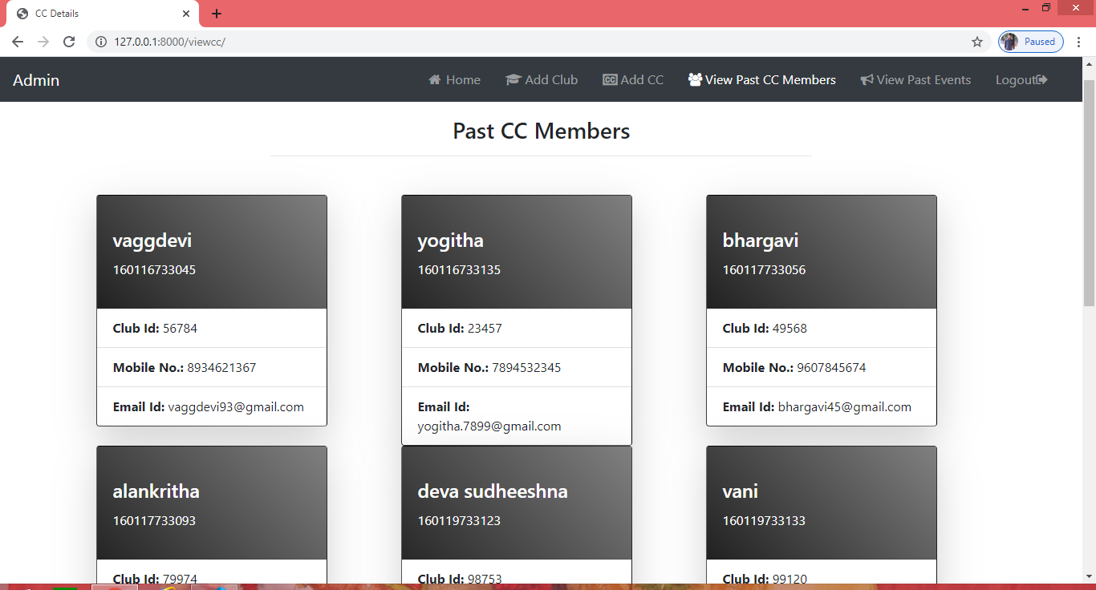
VIEW PAST CC MEMBERS

Slide 28
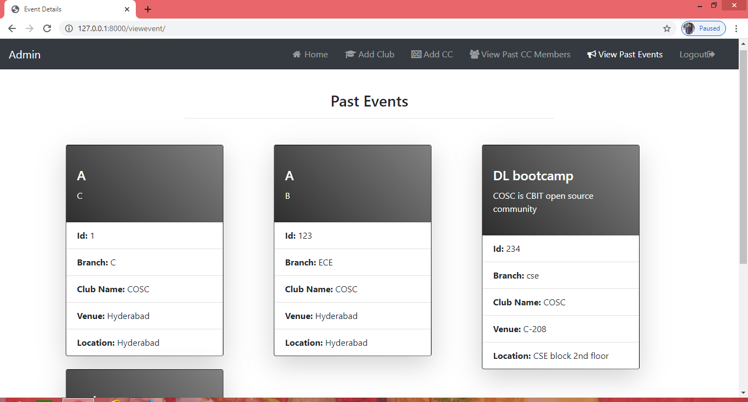
VIEW PAST EVENTS

Slide 29

LOGOUT

